Slide 1

Attrition – Who, When & Why?
By
SHIMANSHU Gera
Akshay Lathwal
Shubham AWASTHI
PRATHMESH MORANE

Slide 2
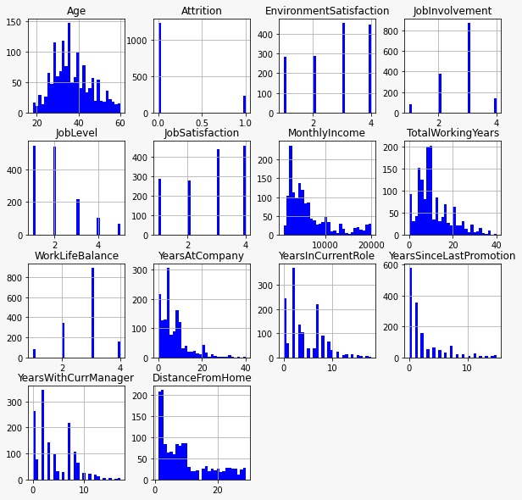
Attrition Data –An Introduction
1. The data has information about employees, their engagement & growth in the company.
2. It is an R&D firm been there for 40 years working on medical and Lifesciences.
3. R&D, Sales, HR departments
4. Studying 1470 employees of this company.
Distribution of various features given in the data set

Slide 3
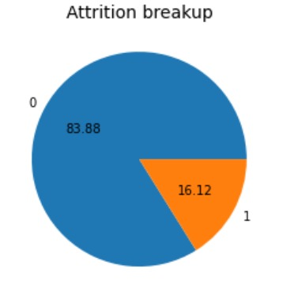
Looking at the Data
20% more males than females
More middle-aged employees
5 different job levels with 60% working in levels1&2.
Feedback from employees :
60% satisfied with their role
60% satisfied with the work environment
70% good work-life balance
The attrition rate is around 16% which is more than the industrial average.
This is to be studied in detail for it to be addressed.

Slide 4
What are the major factors affecting attrition?
1. Age
2. Monthly Income
3. Job level
4. Overtime
5. Marital status
6. Job satisfaction
7. Years since Last Promotion (yslp)
8. Work-Life balance
9. Distance from Home
10. Business travel

Slide 5
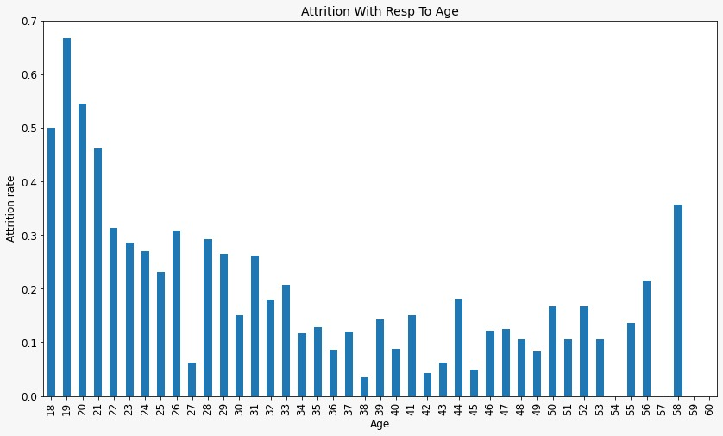
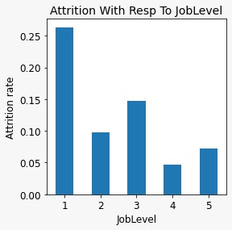
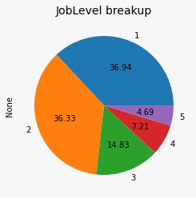
1. Are young employees more prone to leaving the company?
Employees with an age below 30 have a higher attrition rate
More than 30-year-olds seem to be more stable in the company
2. Are employees at lower levels leaving the company?
1. Around 50% of employees leaving the company are from job level.
2. It can be understood that younger employees must be in lower levels and they leave the job for better employment and education opportunities

Slide 6
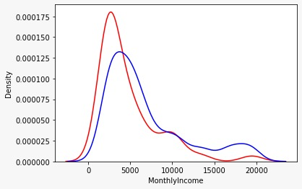
3. What is the effect of income on attrition?
4. Is there any relation between monthly income and job level?
Above $5000, the chance of employees leaving the company is
low.
2. We see that around 50% of the employees earn below $6000. Low income could be a very good reason to leave the company for many employees.
3. Lowe job level lower income.

Slide 7
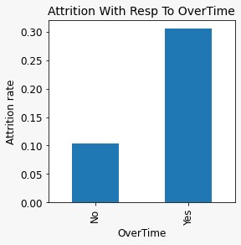
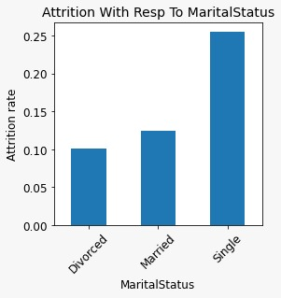
5. Overtime impacts the attrition rate. How is the relation here?
Attrition is very high among employees doing overtime.
While, only around 30% of employees are doing overtime.
6. Marital status, does it have any impact on attrition?
Single employees seem to leave the company more. They are risk-takers.
2. Married employees are less likely to leave the company because of a need for stability.

Slide 8
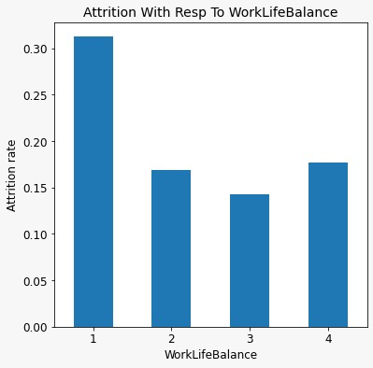
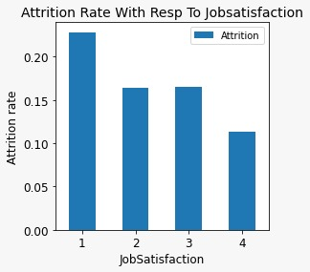
7. We know that 70% have rated a good work-life balance. How is the attrition rate w.r.t this factor?
It can be guessed that the attrition rate will be high among those who perceive a bad work-life balance. It is proven here.
Though little in number, this must be a good reason for a high attrition rate.
8. Most of the employees rated for good job satisfaction. Aren’t they leaving the company?
A job satisfaction level of 3 is also not working for employees to stay in the company.
Seems like there are other factors that are a priority to employees. Can be income, Work-life balance

Slide 9
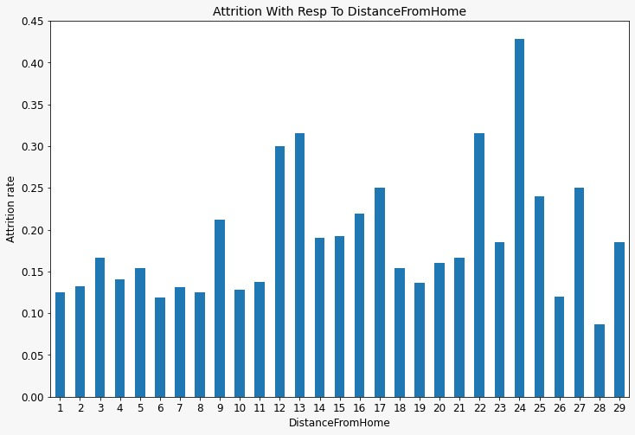
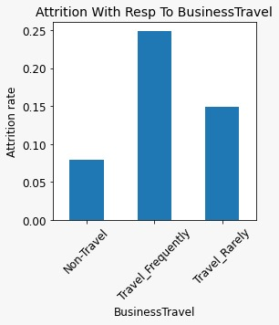
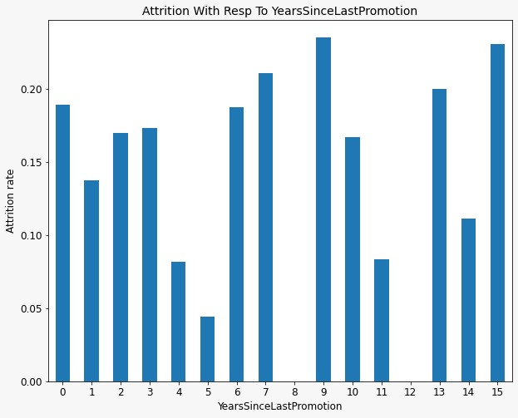
Other Factors :
Distance From Home :
1.
Business Travel :
Years Since last promotion:
A higher attrition rate is seen among employees living far from the office.
It is a very common cause as employees prefer less commuting time and effort.
Attrition is less among employees who don’t travel much
More than 5 years not promoted – high attrition is seen
Interestingly, recently promoted employees, have a higher attrition rate .

Slide 10
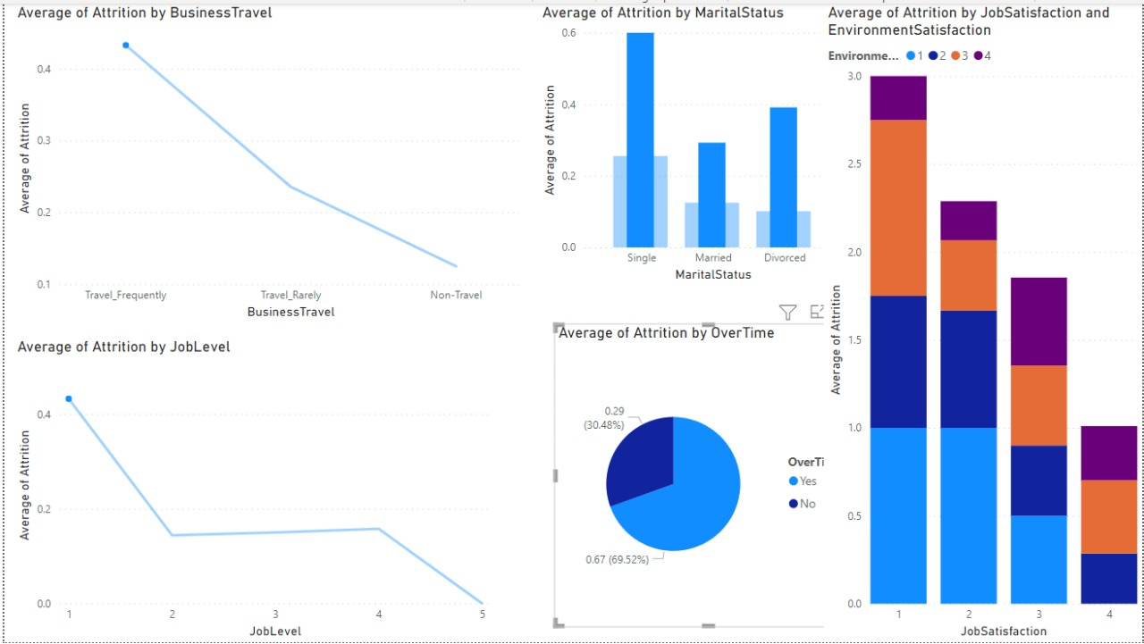

Slide 11
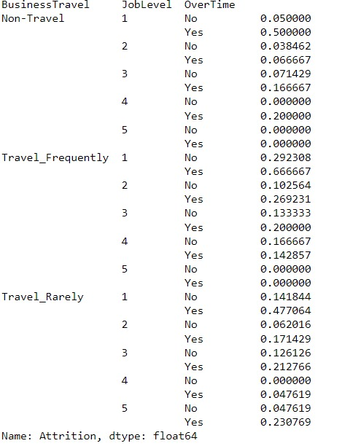
1. An employee in level 1, who works overtime, and travels frequently, will have a 70% chance of leaving the company.
2. Overtime is a major differentiating factor for attrition at lower job levels assuming other things remain constant.
3. Salary, Job level and Age have multi collinearity.

Slide 12
Conclusions
Company should hire married people
OVERTIME WITH extra perks
Increase the income
Job satisfaction & environmental satisfaction should be taken very seriously & make improvements
Flexible working culture e.g work from home, cool down holidays

Slide 13
THANK YOU….

Slide 14
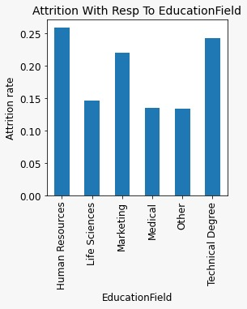
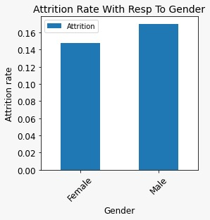
Attrition –Relation with other factors :

Slide 15
Univariate Analysis
Preliminary:
Univariate
Bivariate Analysis
Correlation study: Among all Variables
Multivariate Analysis
Checked for Null values- None found.
Divided Variables into Categorical and Numeric: 11(categorical), 9(Numeric)
Studied the distribution of all variables from box plots and histograms
Studying Attrition rate w.r.t every factor to understand the relation with attrition – Helps us arrive at the possible causes of attrition in the company
Methodology

Slide 16
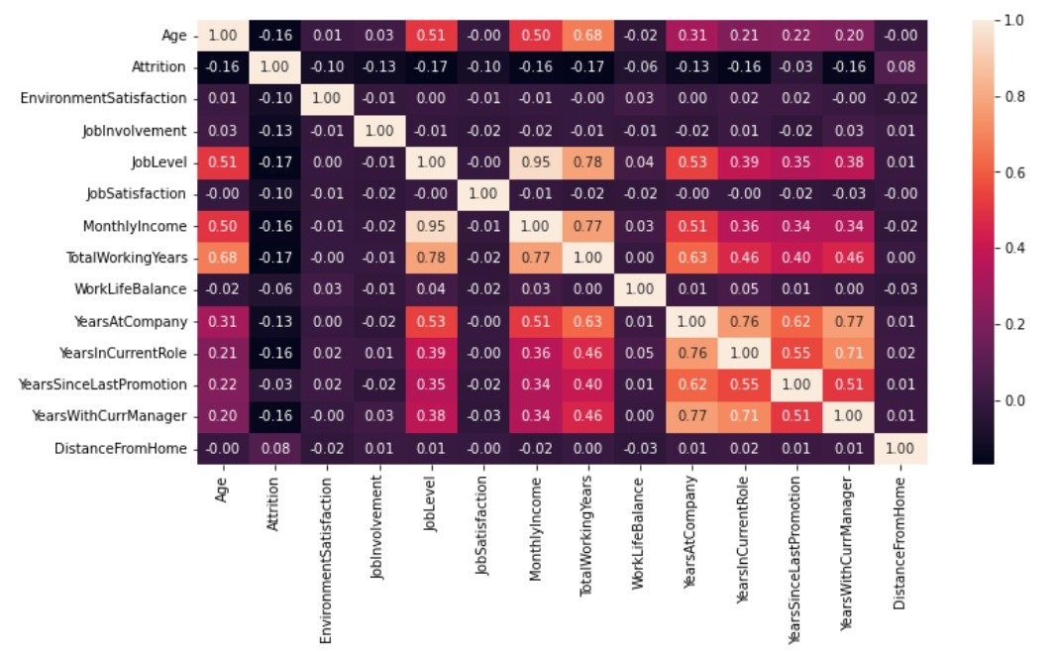
Why Correlation analysis is needed?
We study correlation to understand multicollinearity among the independent variables. Relation between attrition and other independent variables can be seen.
Job level, Total working years Monthly income and age are highly correlated.
YearsAtcomapny, YearsWithCurrent manager and years since last promotion is highly correlated.

